Slide 1
Hidden Markov Models in NLP
Ryan Bordo

Slide 2
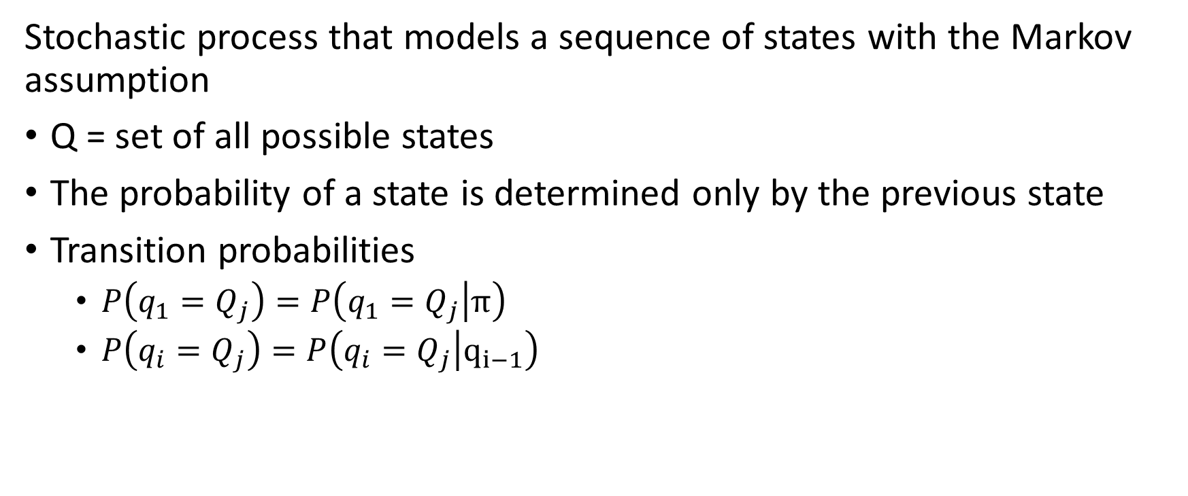
Markov Model
Stochastic process that models a sequence of states with the Markov assumption
Q = set of all possible states
The probability of a state is determined only by the previous state
Transition probabilities
$P\left(q_{1}=Q_{j}\right)=P\left(q_{1}=Q_{j} | π\right)$
$P\left(q_{i}=Q_{j}\right)=P\left(q_{i}=Q_{j} | q_{i−1}\right)$

Slide 3
Why Part of Speech Tag in NLP?
Ideally, we can use a sequence of parts of speech to train a Markov model, but, rarely, is text tagged this way.
Part of speech is more informative than words since a given word can be used for more than one part of speech and structures of sentences are built upon grammar such as part of speech.
Given a sentence, part of speech tags can be inferred using machine learning models.

Slide 4
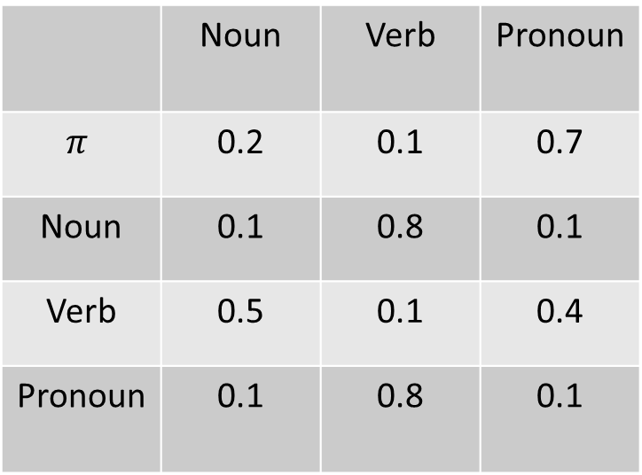
Markov Model Part of Speech Example
Transition Probability Table
Q = {Noun, Pronoun, Verb}
Entries must sum to 1 horizontally
Probability of {Noun, Verb, Pronoun}
 | Noun | Verb | Pronoun
$$π$$ | 0.2 | 0.1 | 0.7
Noun | 0.1 | 0.8 | 0.1
Verb | 0.5 | 0.1 | 0.4
Pronoun | 0.1 | 0.8 | 0.1
$$P\left(q_{1}=Noun,q_{2}=Verb,q_{3}=Pronoun\right)=P\left(Noun | π\right)P\left(Verb | Noun\right)P\left(Pronoun | Verb\right)$$
$$=0.2 ∗ 0.8 ∗ 0.4 = 0.064$$
*By the Markov assumption

Slide 5
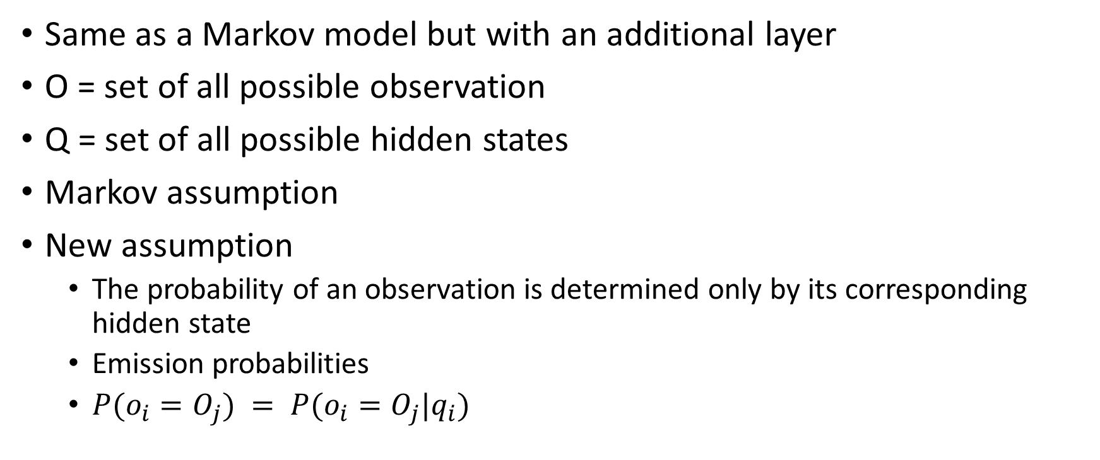
Hidden Markov Model
Same as a Markov model but with an additional layer
O = set of all possible observation
Q = set of all possible hidden states
Markov assumption
New assumption
The probability of an observation is determined only by its corresponding hidden state
Emission probabilities
$P(o_{i}=O_{j}) = P(o_{i}=O_{j}|q_{i})$

Slide 6
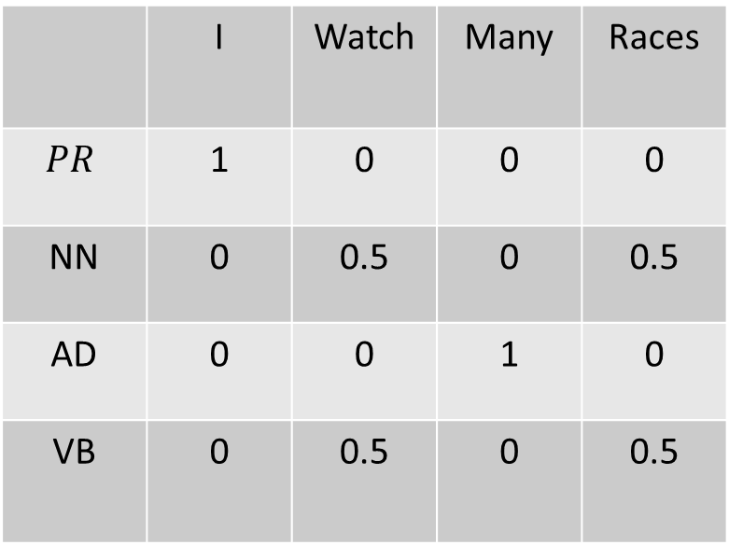
Hidden Markov Model Sentence Example
Emission Probability Table
Additional table
O = {I, Watch, Many, Races}
Q = {PR, NN, AD, VB}
Sometimes “STOP” word used to represent a period
 | I | Watch | Many | Races
$$PR$$ | 1 | 0 | 0 | 0
NN | 0 | 0.5 | 0 | 0.5
AD | 0 | 0 | 1 | 0
VB | 0 | 0.5 | 0 | 0.5

Slide 7
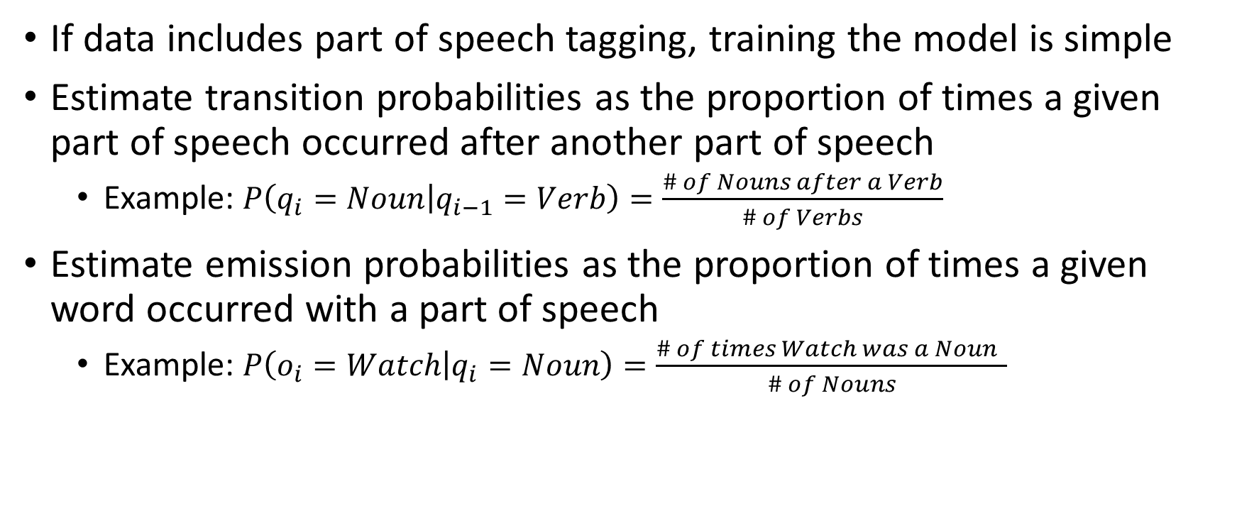
How to Train the Hidden Markov Model
If data includes part of speech tagging, training the model is simple
Estimate transition probabilities as the proportion of times a given part of speech occurred after another part of speech
Example: $P\left(q_{i}=Noun | q_{i−1}=Verb\right)=\frac{\# of Nouns after a Verb}{\# of Verbs}$
Estimate emission probabilities as the proportion of times a given word occurred with a part of speech
Example: $P\left(o_{i}=Watch | q_{i}=Noun\right)=\frac{\# of times Watch was a Noun }{\# of Nouns}$

Slide 8
The Decoding Problem
Given a trained hidden Markov model and a sentence of words, what is the sequence of parts of speech?
To estimate, we will find the sequence of parts of speech that results in the probability given our observed sentence
Potential uses for part of speech decoding
Detecting and filtering out spam emails
Predictive text

Slide 9
$${argmax}_{q_{1},…q_{n}}P\left(q_{1},…q_{n} | o_{1},…o_{n}\right)$$
Decoding Problem

Slide 10
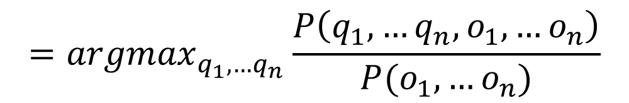
$${argmax}_{q_{1},…q_{n}}P\left(q_{1},…q_{n} | o_{1},…o_{n}\right)$$
$$={argmax}_{q_{1},…q_{n}}\frac{P\left(q_{1},…q_{n},o_{1},…o_{n}\right)}{P(o_{1},…o_{n})}$$
Conditional Probability

Slide 11
$${argmax}_{q_{1},…q_{n}}P\left(q_{1},…q_{n} | o_{1},…o_{n}\right)$$
$$={argmax}_{q_{1},…q_{n}}\frac{P\left(q_{1},…q_{n},o_{1},…o_{n}\right)}{P(o_{1},…o_{n})}$$
$${= argmax}_{q_{1},…q_{n}}P\left(q_{1},…q_{n},o_{1},…o_{n}\right)$$
argmax simplification

Slide 12
$${argmax}_{q_{1},…q_{n}}P\left(q_{1},…q_{n} | o_{1},…o_{n}\right)$$
$$={argmax}_{q_{1},…q_{n}}\frac{P\left(q_{1},…q_{n},o_{1},…o_{n}\right)}{P(o_{1},…o_{n})}$$
$${= argmax}_{q_{1},…q_{n}}P\left(q_{1},…q_{n},o_{1},…o_{n}\right)$$
$${=argmax}_{q_{1},…q_{n}}P\left(q_{1} | π\right)P\left(q_{2} | q_{1}\right)…P\left(q_{n} | q_{n−1}\right)P\left(o_{1} | q_{1}\right)P\left(o_{2} | q_{2}\right)…P\left(o_{n} | q_{n}\right)$$
HMM Assumptions

Slide 13
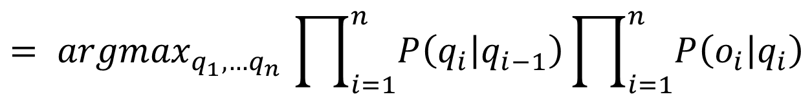
$${argmax}_{q_{1},…q_{n}}P\left(q_{1},…q_{n} | o_{1},…o_{n}\right)$$
$$={argmax}_{q_{1},…q_{n}}\frac{P\left(q_{1},…q_{n},o_{1},…o_{n}\right)}{P(o_{1},…o_{n})}$$
$${= argmax}_{q_{1},…q_{n}}P\left(q_{1},…q_{n},o_{1},…o_{n}\right)$$
$${=argmax}_{q_{1},…q_{n}}P\left(q_{1} | π\right)P\left(q_{2} | q_{1}\right)…P\left(q_{n} | q_{n−1}\right)P\left(o_{1} | q_{1}\right)P\left(o_{2} | q_{2}\right)…P\left(o_{n} | q_{n}\right)$$
$${= argmax}_{q_{1},…q_{n}}\prod_{i=1}^{n}{P\left(q_{i} | q_{i−1}\right)}\prod_{i=1}^{n}{P\left(o_{i} | q_{i}\right)}$$
Simplification

Slide 14
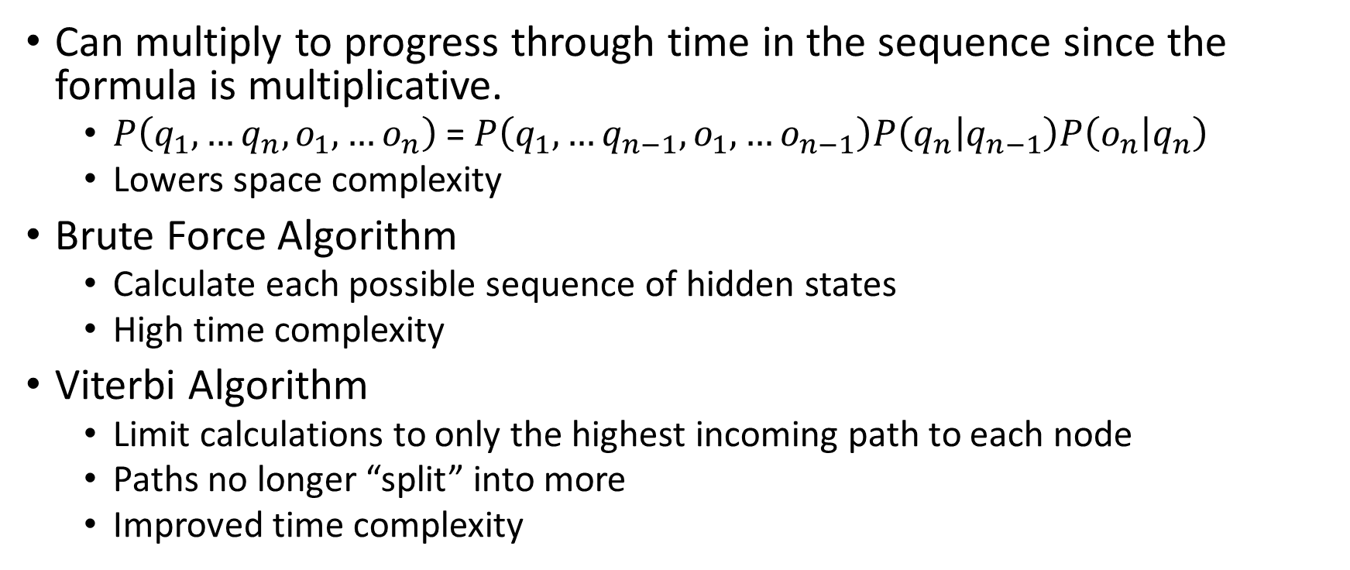
Computation
Can multiply to progress through time in the sequence since the formula is multiplicative.
$P\left(q_{1},…q_{n},o_{1},…o_{n}\right)$ = $P\left(q_{1},…q_{n−1},o_{1},…o_{n−1}\right)P\left(q_{n} | q_{n−1}\right)P\left(o_{n} | q_{n}\right)$
Lowers space complexity
Brute Force Algorithm
Calculate each possible sequence of hidden states
High time complexity
Viterbi Algorithm
Limit calculations to only the highest incoming path to each node
Paths no longer “split” into more
Improved time complexity

Slide 15
Observed:
I
watch
many
races
Hidden:
PR
PR
PR
PR
NN
NN
NN
NN
Start
VB
VB
VB
VB
AD
AD
AD
AD
$$p\left(2\right)=p(1)P\left(q_{2} | q_{1}\right)P\left(o_{2} | q_{2}\right)$$
$$p\left(4\right)=p(3)P\left(q_{4} | q_{3}\right)P\left(o_{4} | q_{4}\right)$$
$$p\left(1\right)=P\left(q_{1} | π\right)P\left(o_{1} | q_{1}\right)$$
$$p\left(3\right)=p(2)P\left(q_{3} | q_{2}\right)P\left(o_{3} | q_{3}\right)$$
t = 0
t = 1
t = 2
t = 3
t = 4

Slide 16




Brute Force: each path represents a computation
PR
PR
PR
PR
NN
NN
NN
NN
Start
VB
VB
VB
VB
AD
AD
…
…
AD
AD
4 paths
16 paths
64 paths
256 paths
$\left|O\right|$paths
${\left|O\right|}^{2}$ paths
${\left|O\right|}^{3}$ paths
${\left|O\right|}^{4}$ paths

Slide 17

Brute Force Time Complexity
${\left|O\right|}^{n}$ calculations
O(${\left|O\right|}^{n}$ ) – worst case time complexity bound
10-word sentence with 10 parts of speech
${10}^{10}$ calculations

Slide 18
Viterbi Algorithm Explanation
PR
PR
PR
PR
NN
NN
NN
NN
Start
VB
VB
VB
VB
AD
AD
AD
…
AD
$$p\left(2\right)=P\left(q_{1},q_{2},o_{1},o_{2}\right)$$
$$p\left(3\right)=p(2)P\left(q_{3} | q_{2}\right)P\left(o_{3} | q_{3}\right)$$
The same calculations follow for each path after the given node, so the maximum path going into the node will yield the max total path after calculations

Slide 19
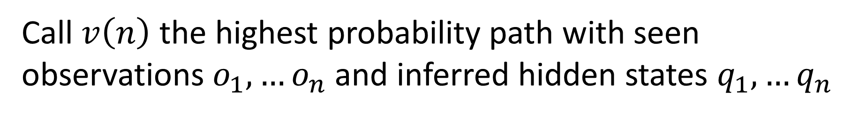
Viterbi Algorithm Mathematically
$${v\left(n\right)= max}_{q_{1},…q_{n}}P\left(q_{1},…q_{n},o_{1},…o_{n}\right)$$
Call $v\left(n\right)$ the highest probability path with seen observations $o_{1},…o_{n}$ and inferred hidden states $q_{1},…q_{n}$

Slide 20
Viterbi Algorithm Mathematically
$${v\left(n\right)= max}_{q_{1},…q_{n}}P\left(q_{1},…q_{n},o_{1},…o_{n}\right)$$
${v\left(n\right)=max}_{q_{1},…q_{n}}P\left(q_{1},…q_{n−1},o_{1},…o_{n−1}\right)P\left(q_{n} | q_{n−1}\right)$ $P\left(o_{n} | q_{n}\right)$
Use of Markov assumptions to decompose the joint probability as the product of the previous joint times the transition and emission probabilities

Slide 21
Viterbi Algorithm Mathematically
$${v\left(n\right)= max}_{q_{1},…q_{n}}P\left(q_{1},…q_{n},o_{1},…o_{n}\right)$$
${v\left(n\right)=max}_{q_{1},…q_{n}}P\left(q_{1},…q_{n−1},o_{1},…o_{n−1}\right)P\left(q_{n} | q_{n−1}\right)$ $P\left(o_{n} | q_{n}\right)$
${v\left(n\right)=\max_{{q_{n−1},q}_{n}}(max}_{q_{1},…q_{n−1}}P\left(q_{1},…q_{n−1},o_{1},…o_{n−1}\right))$ $P\left(q_{n} | q_{n−1}\right)$ $P\left(o_{n} | q_{n}\right)$
Can rewrite the expression with a nested max

Slide 22
Viterbi Algorithm Mathematically
$${v\left(n\right)= max}_{q_{1},…q_{n}}P\left(q_{1},…q_{n},o_{1},…o_{n}\right)$$
${v\left(n\right)=max}_{q_{1},…q_{n}}P\left(q_{1},…q_{n−1},o_{1},…o_{n−1}\right)P\left(q_{n} | q_{n−1}\right)$ $P\left(o_{n} | q_{n}\right)$
${v\left(n\right)=\max_{{q_{n−1},q}_{n}}(max}_{q_{1},…q_{n−1}}P\left(q_{1},…q_{n−1},o_{1},…o_{n−1}\right))$ $P\left(q_{n} | q_{n−1}\right)$ $P\left(o_{n} | q_{n}\right)$
$v\left(n\right)=\max_{{q_{n−1},q}_{n}}v(n−1)$ $P\left(q_{n} | q_{n−1}\right)$ $P\left(o_{n} | q_{n}\right)$
Can rewrite the max as with our function, seeing that the highest probability path can be found recursively

Slide 23
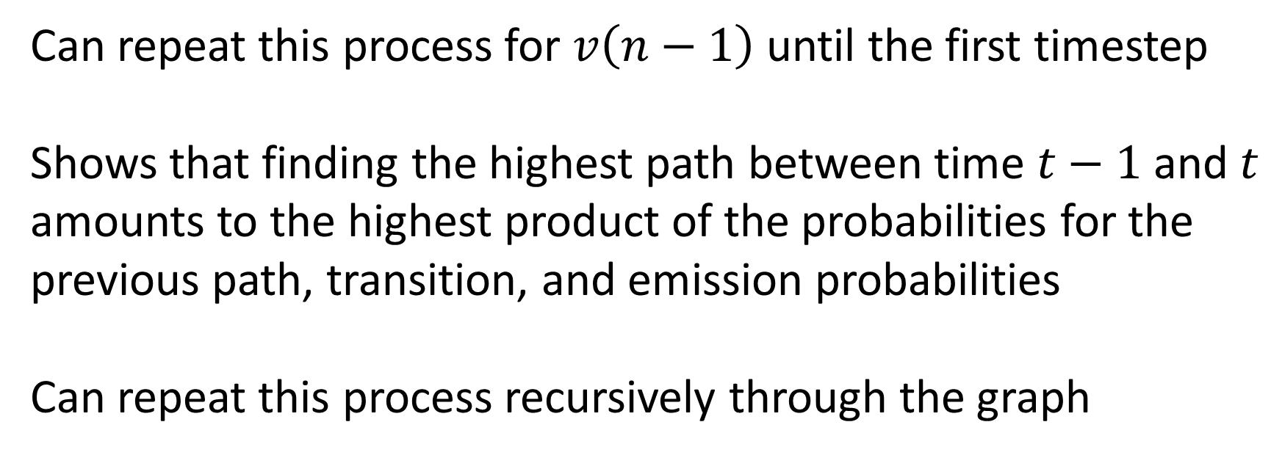
Viterbi Algorithm Mathematically
$v\left(n\right)=\max_{{q_{n−1},q}_{n}}v(n−1)$ $P\left(q_{n} | q_{n−1}\right)$ $P\left(o_{n} | q_{n}\right)$
Can repeat this process for $v\left(n−1\right)$ until the first timestep
Shows that finding the highest path between time $t−1$ and $t$ amounts to the highest product of the probabilities for the previous path, transition, and emission probabilities
Can repeat this process recursively through the graph

Slide 24




Viterbi Algorithm: each path represents a computation
PR
PR
PR
PR
NN
NN
NN
NN
Start
VB
VB
VB
VB
AD
AD
…
…
AD
AD
4 paths
20 paths
36 paths
52 paths
$\left|O\right|$paths
$\left|O\right|+{\left|O\right|}^{2}$ paths
$\left|O\right|+{2\left|O\right|}^{2}$ paths
$\left|O\right|+{3\left|O\right|}^{2}$ paths
At each time step, $\left|O\right|$ paths will be calculated from $\left|O\right|$ nodes, totaling ${\left|O\right|}^{2}$ paths.

Slide 25
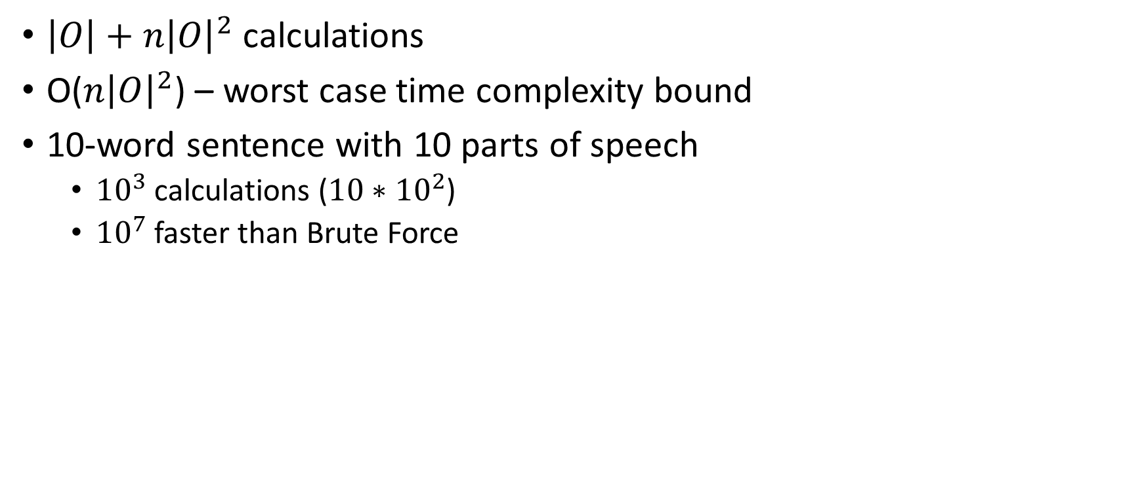
Viterbi Time Complexity
$\left|O\right|+{n\left|O\right|}^{2}$calculations
O(${n\left|O\right|}^{2}$) – worst case time complexity bound
10-word sentence with 10 parts of speech
${10}^{3}$ calculations (${10∗10}^{2}$)
${10}^{7}$ faster than Brute Force

